Slide 1
PacMan DQN
202531016이정훈

Slide 2
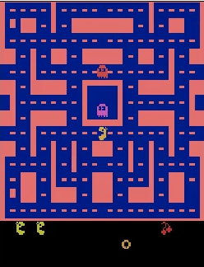
01
Outline
- Game : Pac-Man
- Goal : 유령을 피해서 화면 상의 모든 펠렛을 수집하는 것
- open-AI gym, tensorflow API를 이용한 reinforcement learning
- open-AI gym : MsPacman-v0
- Agent
- Environment
- tensorflow
- Deep-Q-Network(DQN)

Slide 3
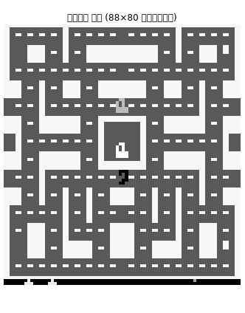
02
State
- env = gym.make(“MsPacman-v0”)
obs = env.reset()
obs.shape
- Output : (210, 160, 3)
- Observation Space Preprocessing
- (88, 80, 1)으로 reshape
-
[[-74] [-74] [-74] [-74] [ 22] [ 22] [-74] [-74] [-74] [-74] [-74] [-74] [-74] [-74] [-74] [-74] [-74] [-74] [-74] [-74] [-74] [-74] [-74] [-74] [-74] [-74] [-74] [-74] [-74] [-74] [-74] [-74] [ 22] [ 22] [-74] [-74] [-74] [-74] [-74] [ 27] [ 27] [-74] [-74] [-74] [-74] [-74] [ 22] [ 22] [-74] [-74] [-74] [-74] [-74] [-74] [-74] [-74] [-74] [-74] [-74] [-74] [-74] [-74] [-74] [-74] [-74] [-74] [-74] [-74] [-74] [-74] [-74] [-74] [-74] [-74] [ 22] [ 22] [-74] [-74] [-74] [-74]]

Slide 4
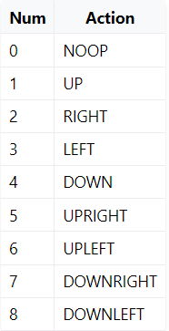
03
Action
- env.action_space
- Output : Discrete(9)

Slide 5
03
Action
- action = epsilon_greedy(q_values, step)
- eps_min = 0.1
eps_max = 1.0
def epsilon_greedy(q_values, step):
epsilon = max(eps_min,
eps_max - (eps_max-eps_min) * step/eps_decay_steps)
if np.random.rand() < epsilon:
return np.random.randint(n_outputs) # 랜덤 행동
else:
return np.argmax(q_values) # 최적 행동

Slide 6
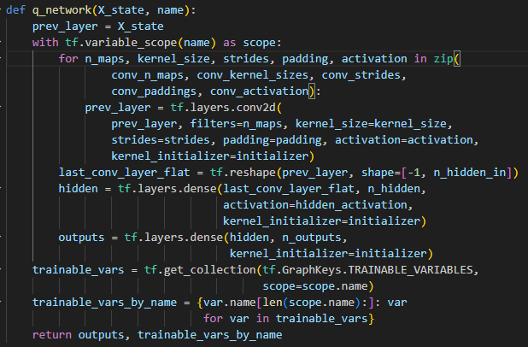
03
Action
- q_values = online_q_values.eval(feed_dict={X_state: [state]})
tensorflow 신경망을 통해 q 학습
- 합성곱 신경망
- 가중치 초기화 : Xavier 초기화
- 신경망 activation function : ReLu

Slide 7
04
Reward
- obs, reward, done, info = env.step(action)
- 대부분의 상황에서 reward는 0
- 특정 상황에서 reward 반환

Slide 8
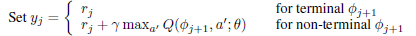
05
Replay Memory
- replay_memory 저장
- replay_memory.append((state, action, reward, next_state, 1.0 - done))
- replay memory에서 sampling
- X_state_val, X_action_val, rewards, X_next_state_val, continues = (
sample_memories(batch_size))
- Target DQN에서 target-q-value 반환
- next_q_values = target_q_values.eval(
feed_dict={X_state: X_next_state_val})
- sample 별 action q_value의 최댓값 구함
- max_next_q_values = np.max(next_q_values, axis=1, keepdims=True)
- 학습을 위한 target-q-value 계산
- y_val = rewards + continues * discount_rate * max_next_q_values
-
Replay Memory

Slide 9
06
Update
- Online DQN 학습
- _, loss_val = sess.run([training_op, loss], feed_dict={
X_state: X_state_val, X_action: X_action_val, y: y_val})
Replay Memory

Slide 10
07
Iteration
Replay Memory

Slide 11
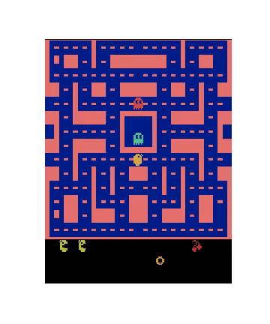
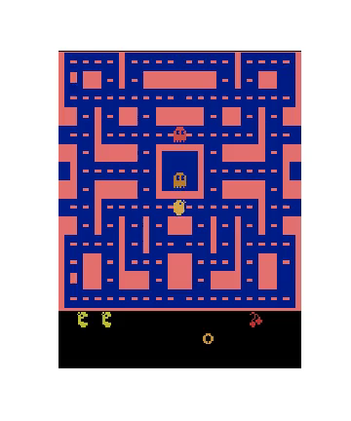
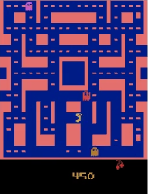
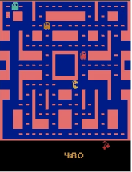
08
Result
- 300000 steps
- 400000 steps

Slide 12
09
Reference
- https://github.com/ExcelsiorCJH/Hands-On-ML/blob/master/Chap16- Reinforcement_Learning
- CS234 Reinforcement Learn Lecture 6: CNNs and Deep Q Learning

